Slide 1

Data Science for Public Good Summer Program

Slide 2


Who Are We?
Social and Decision Analytics Laboratory is part of the Biocomplexity Institute of Virginia Tech
The study of life and environment as a complex system
Understanding biology in the context of ecosystems and human-created systems
Transdisciplinary team science “From Molecules to Policy”

Slide 3
Social & Decision Analytics Lab
The Social and Decision Analytics Laboratory brings together statisticians and social and behavioral scientists to embrace today’s data revolution, developing evidence-based research and quantitative methods to inform policy decision-making.
Science of All Data
Community Learning Data Driven Discovery
Education and Labor Force Analytics
Health and Well Being Analytics
Emergency Management Analytics
Industrial Innovation Analytics
Information Diffusion Analytics
Notes:
Our lab an intentional collection of statisticians and social scientists who have a common vision to study the social condition quantitatively at scale.
Our overarching research thrust is creating and developing the science of all data and Community Learning Data Driven Discovery Analytics.
We did not set out to do what we are doing today. We thought we would focus on topics related to megacities but, as we began to work with our local community, our focus shifted.
Our goal is to bring Data Science to our 3000 communities primarily small and medium sized and rural local governments.
An important aspect of our research is how information reaches people and affects their outlook and actions.

Slide 4


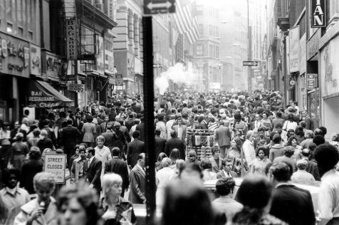
Social & Behavioral Data Flows
Infrastructure
Environment
People
Condition
Operations
Resilience
Sustainability
Climate
Pollution
Noise
Flora/ Fauna
Relationships
Location
Economic Condition
Communication
Activities
Health

Slide 5

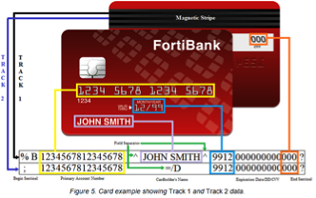

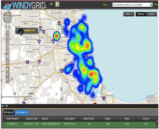




All Data Revolution
Designed Data
Collections
Statistically designed and intentional observational data collections
Administrative Data
Data collected for the administration of an organization or program
Opportunity Data
Data generated as we move through our daily paces
Procedural Data
Data derived from policies and procedures
Notes:
We put data into 4 buckets that helps us explain the data;
1. Statistically designed and intentional observational data collections from surveys and experiments, such as those using data from telescopes;
2. Moving to the right, there are opportunity data – data from fitbits, internet, GPS, social media, sensors – where a lot of the hype of Big Data rests;
3. Procedural data - how to processes and policies shape our lives – this is especially important for our research in examining DOD communities.
4. Administrative data – Data collected for the administration of an organization or program - these data have huge potential that is just so untapped.
We can repurpose these data and no new data collection is required.

Slide 6


Data Science for Public Good Summer Program

Slide 7

DSPG Summer Program
"The collaborative nature of the lab provides students with a holistic and diversified experience which prepares them to contribute meaningfully to research projects. Each research scientist at the lab contributes a unique perspective, enriching both the projects we work on, as well as the interests and aspirations of the students in the program. This access to a professional network has extended far beyond my summer experience, and reaches across many universities and institutions."
- Madison Arnsberger, DSPG Fellow 2016

Slide 8
DSPG Program Overview
Ten weeks from May 22 to July 28, 2017, in Arlington, VA
paid fellowship graduate national search working directly with faculty, undergrads from VT (Honors program) receive credits
Team research with dedicated graduate students, postdocs and faculty
Horizontally and vertically integrated teams (multidisciplinary), in collaboration with sponsors
Individualized mentors working closely with students
Participation in all the laboratory’s project activities
Professional training through development workshops and seminars
Final presentation of research projects at closing poster session (https://www.bi.vt.edu/sdal/careers/call-for-students/student-poster-presentations note to creative team: Poster Session on the news)
Technical report and publication opportunities (AMSTAT article)

Slide 9
Who Is Eligible?
The DSPG program is open to two groups of students:
Undergraduate students currently enrolled in Virginia Tech's Honors Program
Graduate students currently enrolled at any U.S. university can apply for our funded fellowship positions by following the application process outlined directly below.
DSPG Alumni previously enrolled students interested in taking part in DSPG program again.

Slide 10
DSPG Fellow Applications
Deadline: February 1, 2017.
Requirement is to have a completed bachelor's degree in any discipline from an accredited academic institution or be actively enrolled as a master's or PhD student at a U.S. university.
Complete our online application and diversity data survey.
Request two personal references (teachers, mentors, or employers)

Slide 11
DSPG Honors Program Applications
Deadline: March 1, 2017.
Requirement is to enroll in the following courses during the Summer I and Summer II semesters:
Summer I UH 4504: Honors Discovery and Innovation Studio (3 credits) UH 4994: Honors Undergraduate Research (3 credits)
Summer II UH 4504: Honors Discovery and Innovation Studio (3 credits) UH 4994: Honors Undergraduate Research (3 credits)

Slide 12
Make a Real Impact
An opportunity to pursue community-based research projects which inform ethical policymaking and address real-world problems.(https://www.bi.vt.edu/sdal/projects)
Our projects help guide the creation of resilient communities, inform effective policy responses to public health crises, and uncover key factors that drive industrial innovation.
“While classwork is heavy on numbers, being able to work directly with people at Arlington County government is eye-opening. It gives you a broader context and changes your world view.”
- Adrienne Rogers, DSPG Fellow 2015

Slide 13
Diversify Your Expertise
Individualized mentors in a wide variety of fields: statistics, social, behavioral and economic sciences, computer science, simulation, data analytics, information technology policy, and infrastructural resilience.
"The interdisciplinary work environment made it easy to connect and have conversations. If I wanted to ask a question about another field of research, there was always a door I could knock on."
- DSPG Fellow 2016

Slide 14
Experience Team Science
Work in a vertically and horizontally integrated team environment—our project groups combine diverse levels of experience (students, post-docs, researchers, and federal leaders) with a range of academic perspectives (data science, statistics, and social sciences.)
"We never felt limited by our individual skill sets because collaboration provided so many natural opportunities for us to learn from one another. Colleagues with a background in statistics would teach those of us with experience in computer programming and vice versa."
- DSPG Fellow 2016

Slide 15
Form Professional Connections
Engagement with practitioners and researchers through SDAL’s Visiting Scholar program, which includes economists, statisticians, and other social science researchers with diverse federal and private sector experience.
Direct interaction with decision-makers in industry and government agencies through field trips and regular policy events on Capitol Hill and the surrounding area.

Slide 16
Resources
Training in essential tools for scientific and statistical computing such as Hadoop, R, Python, GIS, other software tools as needed for projects
Access to a state-of-the-art parallel cluster with high-performance interconnect in the Biocomplexity Institute of Virginia Tech’s High-Performance Computing Facility

Slide 17

Selected Research Projects from DSPG 2016

Slide 18
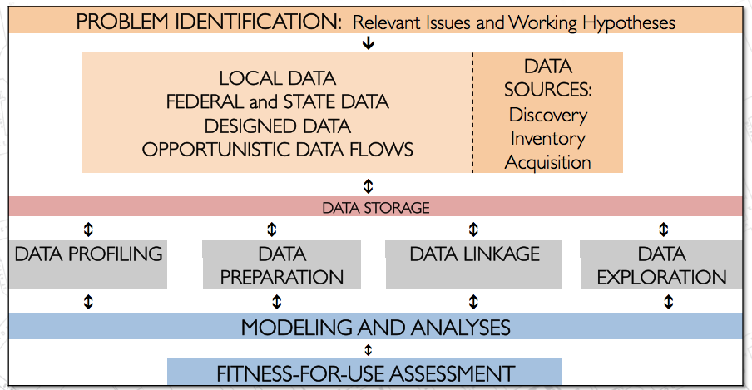
Research Method
Projects start with engagement with community leaders, and identification of the research questions.
Review of literature to identify current practice and working hypotheses.
Identify data sources (i.e., designed data collections, administrative, opportunity, and procedural data) for inventory, acquisition, and preparation.
Address questions through modeling and analyses.

Slide 19
Arlington County FIRE/EMS 911 Data

Slide 20
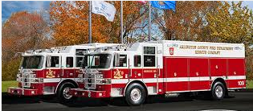
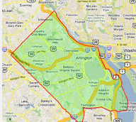
Arlington County Fire Department
Improve quality of life and services while accelerating the county’s efficiency and resiliency
Situational Awareness
Emergency 911 calls
Non-profit networks and social cohesion of neighborhoods
Map the “age” of the county

Slide 21
Recreate 911 incidents, End-to-End, Through the Data
Fire
and
EMS Data
Notes:
Transition – exciting – how can we add value to the national data? Trying to look at and leverage local administrative data flows. This is what we are exploring with the fire department.
Tie in hot spots and relationship back to vulnerable populations.
Local - state and federal data integration of data.
We were asked if we can recreate 911 incidents, end-to-end, through the data
The fire/ems data are stovepiped within each domain.
What are trends in total incidents
Hour of day, day of week, month, incident type, unit type?
What is impact of weather?
Are the right resources deployed?
What is a loyal customer?
When is ‘right of refusal’ used?
What is utilization by unit?
What can be gained through the use of social media?

Slide 22


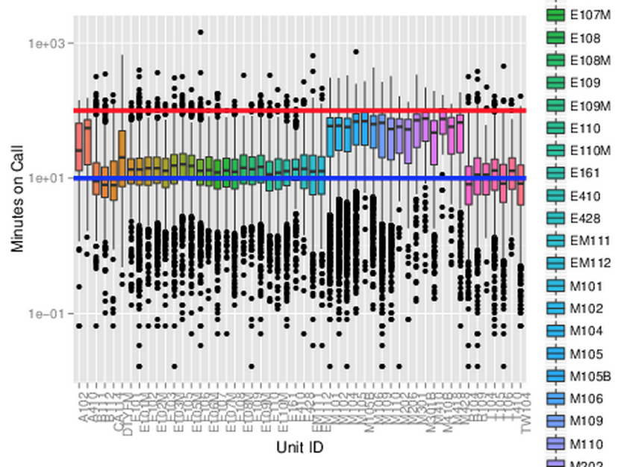
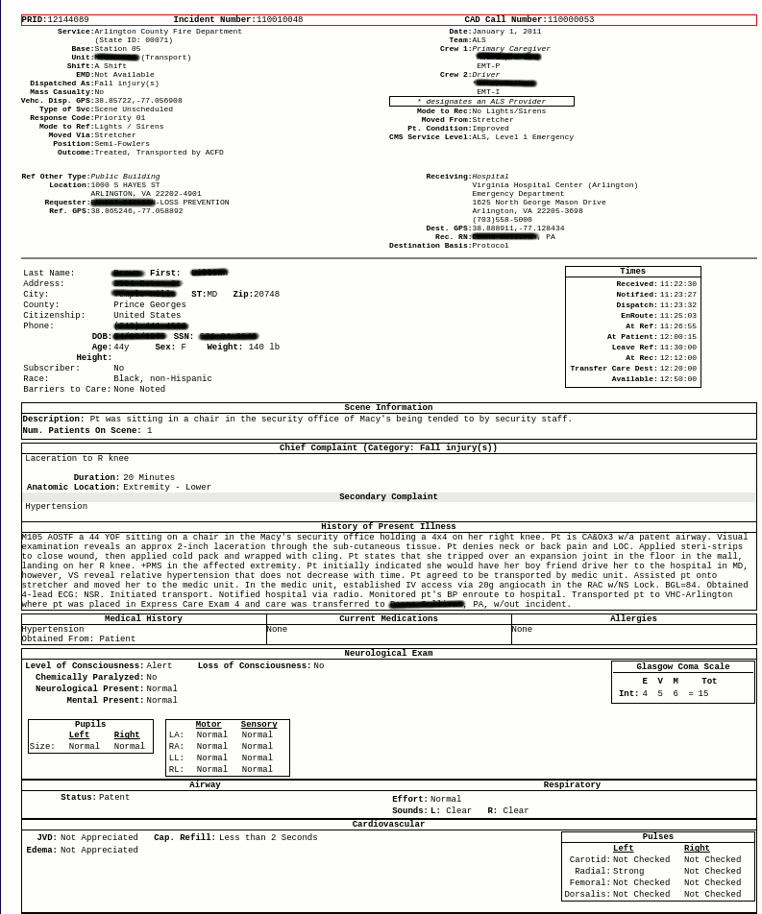
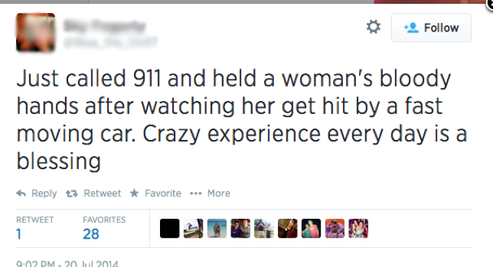
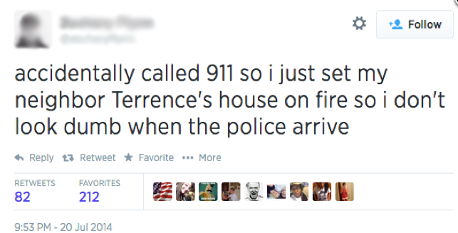
Notes:
Battalion Chief Mike Gowen was terrific in taking us on tours of the CAD center and FD and helped us understand how the data were born. This is an example of the digital traces that Sallie talked about.
The call comes into the CAD center, the same resources are deployed, no matter the urgency of the event, after action reports are prepared for each fire and medic unit sent out. But none of these data are integrated to look at incidents end to end.
We were able to connect the data requiring much wrangling and reverse engineering of the data.

Slide 23
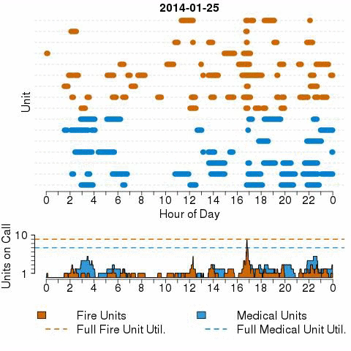
Linking Incident Linked Across Time
Minutes on Call

Slide 24
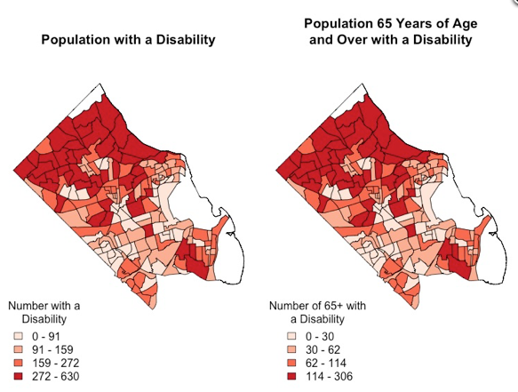
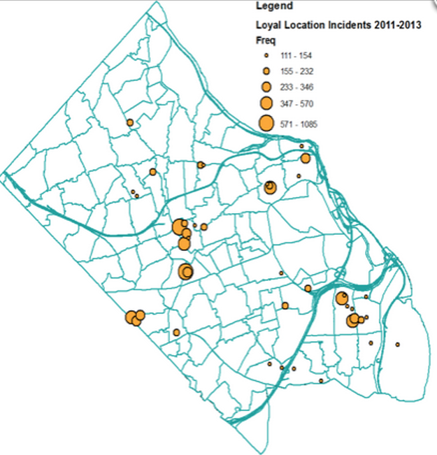
Do We Have Loyal Customers or Loyal Locations?
Link up data with geography
Identifies hotspots
Deeper look into data and find these align with populations at risk in community
Notes:
Our hot spots don’t rely on tracking people, but allow you to identify the hot spots through the rhythm.
Tie back to federal data – identifying vulnerable populations. With one single data flow, we found where to look for them,

Slide 25
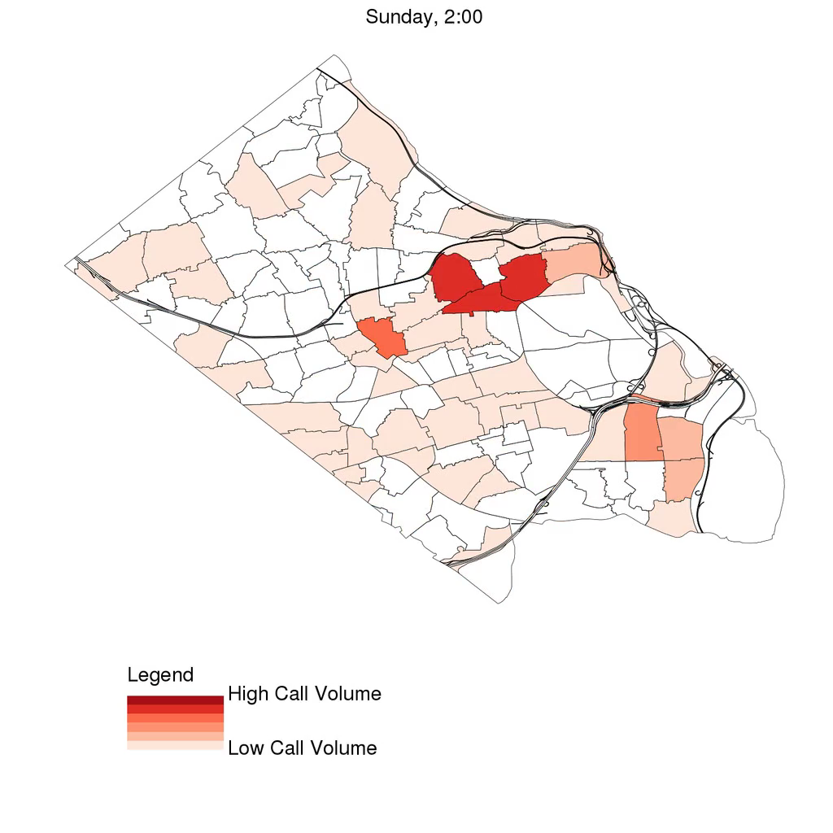
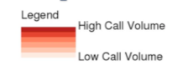
Through this single source we have identified a rhythm of the city
What do you think the data are telling us?

Slide 26
PREDICTING SMOKE ALARM NEED IN ARLINGTON COUNTY

Slide 27
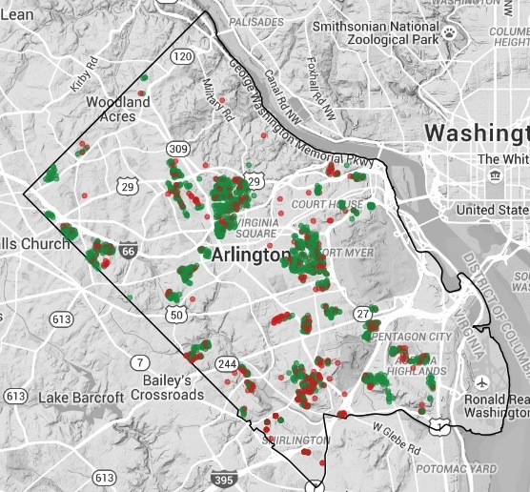
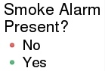
Arlington Operation FireSafe
Goal: to increase the number of residences in Arlington with smoke alarms
Build a predictive model to identify homes most in need of an alarm
Data Sources:
Operation FireSafe - Arlington County Fire Department visited 1733 homes, 32% did not have an alarm
Housing data - house value, size, age, number of bedrooms, and tenure for 60,343 housing units in Arlington County
ACS 2014 – demographic (age, sex, race) and socioeconomic variables (income, poverty, education, SNAP, household composition) at the block group
Notes:
The goal for Operation Firesafe is to increase the number of residences in Arlington with smoke alarms
Arlington County Fire Department visited 1733 homes, 32% did not have fire alarm. Fortunately for us, they collected data about this!
We mapped the Operation Firesafe data with Housing data such as house value, size, age, number of bedrooms, and ownership, for 60,343 housing units in Arlington County
Added in demographic data from the Federal American Community Survey.
Note – use of three types of data flows from local to federal.

Slide 28
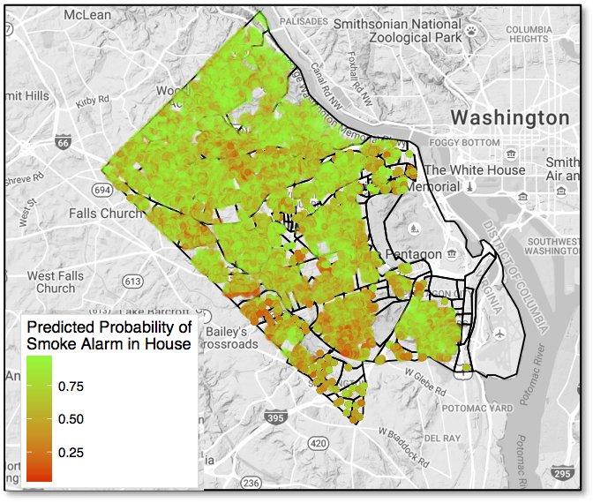
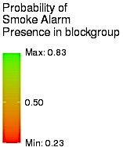
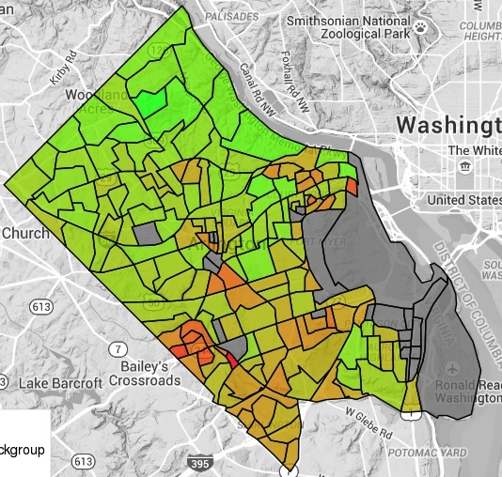
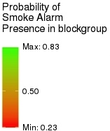
Probability of Having a Smoke Alarm
Bayesian Logistic Regression Model with
Conditionally Autoregressive Spatial Effects
Census Block Level Predictions
Housing Unit Level Predictions
Notes:
Using a Bayesian logistic regression model to estimate the probability that a housing unit has a smoke alarm.
The results show that the Fire Dept. should focus on the southwest (bottom left hand corner) of Arlington.
This is an example of an issue that required mapping multiple sources of different kinds of data to inform a topic.

Slide 29
The Use of Social Media by the Army Population

Slide 30
Research Questions
Social media offers a new opportunity to capture Soldiers’ well-being and/or concerns about the Army.
Goal: Explore the use of social media by the U.S. Army population.
Are there differences in topics and sentiments across groups (e.g., Soldiers vs. family) and across social media venues?
Can we identify determinants of attrition and changes in policies through the chatter in social media?

Slide 31



Data & Methods
Facebook
34 Army/military related pages
Pages grouped in 6 categories: Army Bases, Official Army, Unofficial Army, Unofficial Military, Army Family, and Military Family
6,089,415 comments from 191,342 posts until July 5, 2016
Twitter
43,409 tweets from 1,296 users between 2014 to 2016
8,938 Army/military related hashtags
Youtube
68 videos on 10 different topics such as education (e.g., college, GI bill), health (e.g. suicide, PTSD), quality of life (e.g., life on base, mail, food), sexual assault of women, and transgender
9,791 comments from the videos
Notes:
The study focuses on Facebook, Twitter, and YouTube as they are the most commonly used social media platforms. They provide users with a free application programming interface (API) that facilitates the collection of the data.
Pablo Barbera, Michael Piccirilli and Andrew Geisler (2016). Rfacebook: Access to Facebook API via R. R package version 0.6.3. https://CRAN.R-project.org/package=Rfacebook
Jeff Gentry (2015). twitteR: R Based Twitter Client. R package version 1.1.9. https://CRAN.R-project.org/package=twitteR
Timothy Graham & Robert Ackland and with contribution from Chung-hong Chan (2016). SocialMediaLab: Tools for Collecting Social Media Data and Generating Networks for Analysis. R package version 0.22.0. https://CRAN.R-project.org/package=SocialMediaLab

Slide 32
Sentiment Comparisons
Facebook (dark blue) and Twitter (light blue) have strikingly similar sentiment.
The sentiments on YouTube (red) are more negative than either Facebook or Twitter.
This may be due to the increased anonymity afforded by YouTube.
Notes:
Jockers ML (2015). _Syuzhet: Extract Sentiment and Plot Arcs from Text_. <URL: https://github.com/mjockers/syuzhet>.

Slide 33
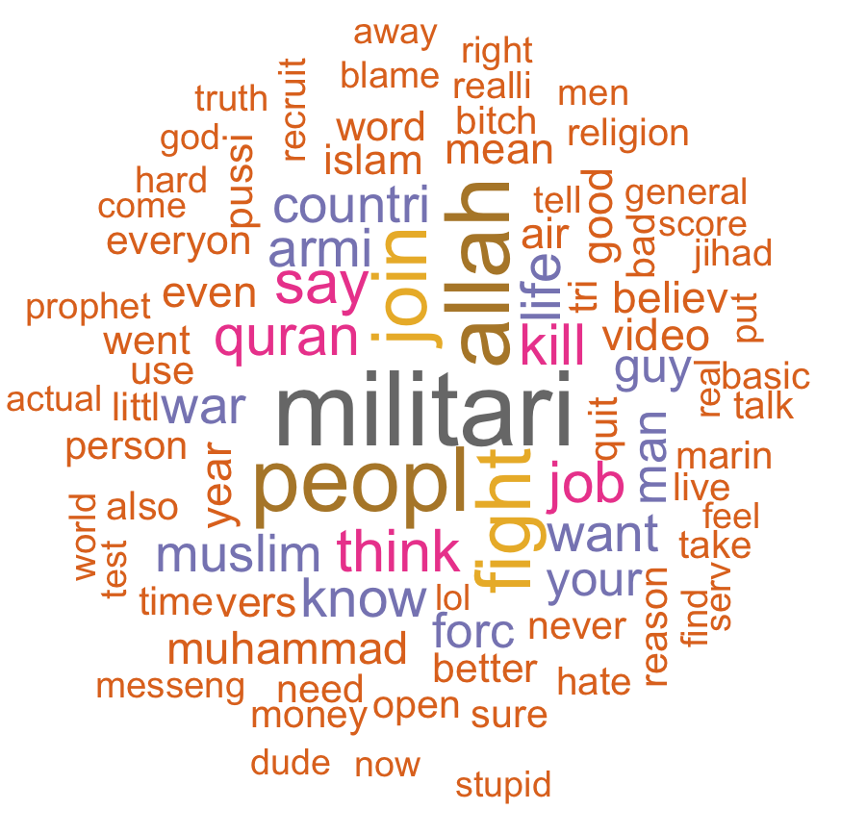
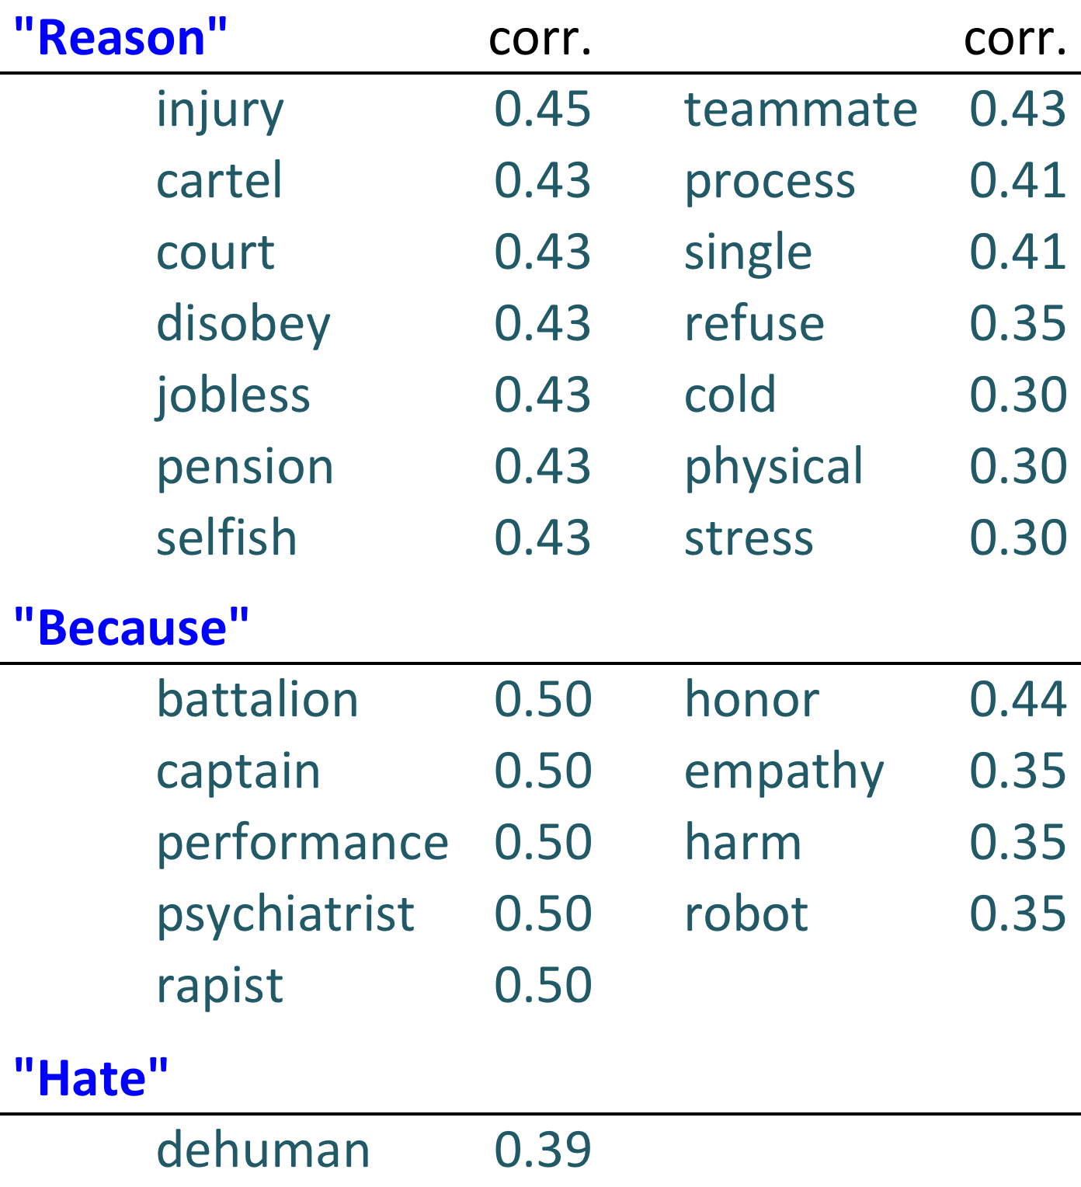
“Why I Quit the Army”
Identified 6 videos with titles related to Soldiers leaving the Army.
Analyzed the word frequencies and correlations between selected relevant words in the comments of these videos.
Notes:
*Words with correlations above/equal to 0.30 are reported
Words related to job, religion, war are used frequently.
Injury, pension, performance, stress are highly correlated with the words “reason”, “because”, “hate.”

Slide 34
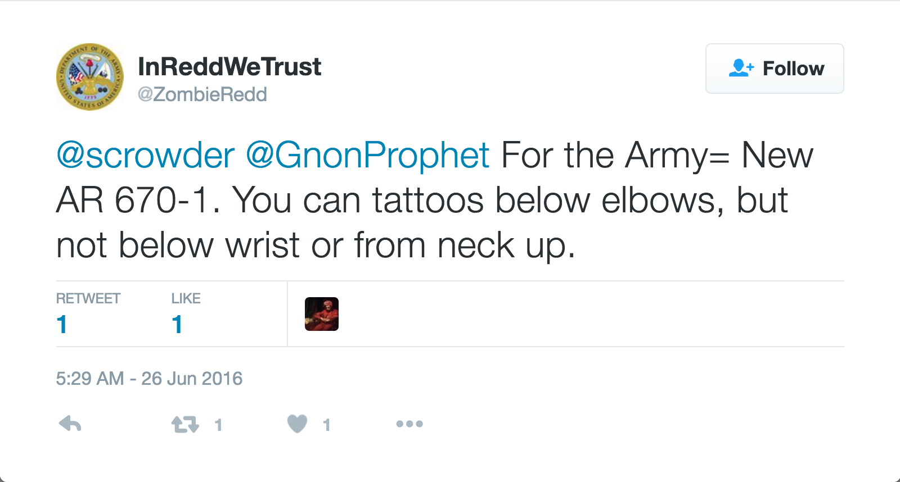
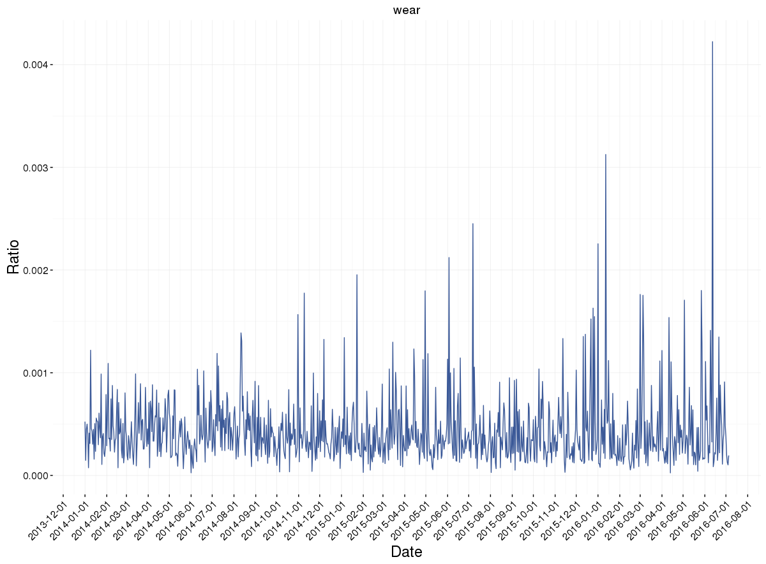



Identifying Policy Changes Over Time
The daily frequency of each word from 2014 to present was counted.
The spikes relevant to specific policies introduced/changed during the same period were identified.
As illustration, below plots display the frequency of the word “WEAR” on Facebook and Twitter; the peaks correspond to the dates of uniform policies.
???
The daily frequency of each word from 2014 to present was counted.
The spikes relevant to specific policies introduced/changed during the same period were identified.

Slide 35
School Assignment Policies & Race A comparison of Jefferson county & mecklenburg county school districts

Slide 36
Motivation
Although segregation was deemed unconstitutional more than 50 years ago, many schools across the country remain segregated due to state and country policies.
Students in segregated schools are often deprived of the positive outcomes associated with integrated school settings*:
better critical thinking
communication
social skills
lack of poverty
*Orfield, G., Frankenberg, E., Ee, J., & Kuscera, J. (2014, May 25). Brown at 60: Great Progress, a Long Retreat and an Uncertain Future. Civil Rights Project.

Slide 37
Research Questions
Jefferson County has implemented a complex integration plan. Can a difference in the racial distribution of students be distinguished when compared to an integration plan based solely on location?
Are Jefferson County schools more racially integrated?
Can the integration be demonstrated spatially?
Is the plan to achieve its goals of desegregation working?

Slide 38
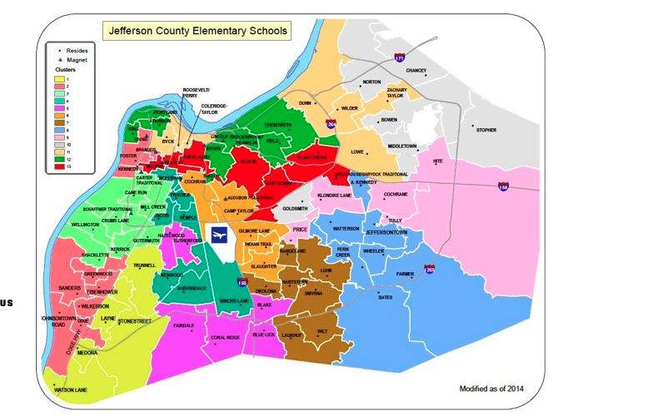
Policy Review
Jefferson County
Elementary School Clusters
1975: Kentucky Board of Education mandates a race-based busing system to promote desegregation.
2007: Meredith vs. Jefferson County Public School : Deemed unconstitutional to integrate schools solely on the basis of race. A new plan that aspires to create integrated clusters on the basis of income, family education level, and percent whiteness was developed and is currently in place.

Slide 39
Policy Review Continued
Mecklenburg County
Elementary School Assignment
1971: Swann vs. Charlotte-Mecklenburg Board of Education: The Supreme Court’s first metropolitan wide desegregation decision.
2002: Racial based integration ended. Public schools began to re-segregate and have remained so to present times. Students are assigned to schools solely based on geographic location.

Slide 40
Data
Statewide Longitudinal Data Systems (SLDS)
Jefferson CO, KY and Mecklenburg CO, NC
Academic Year 2013-2014
Elementary public school grades 3-5
88 in Jefferson County
103 in Mecklenburg County

Slide 41
Method
Descriptive Analysis
Polar histograms depict the racial breakdown, as a percentage, for the Jefferson County and Mecklenburg County school districts. Each bar on the charts represents an individual elementary school within the respective county
In the Jefferson County plot, the schools are grouped into the 13 clusters defined in the school assignment plan
Spatial correlation graphs display the location and proportion of White and Black students within a school; each point represents a school and the size of the point the proportion

Slide 42
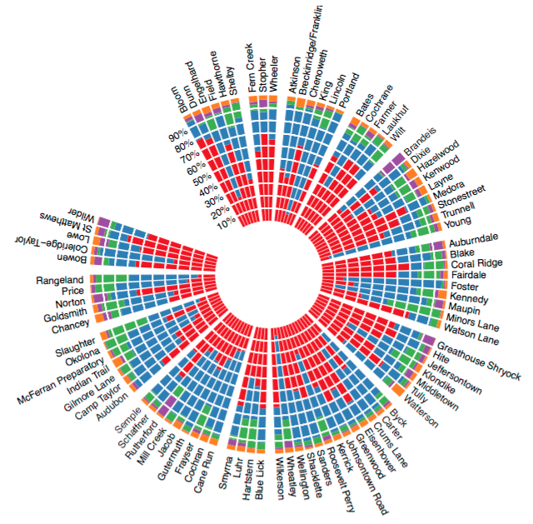
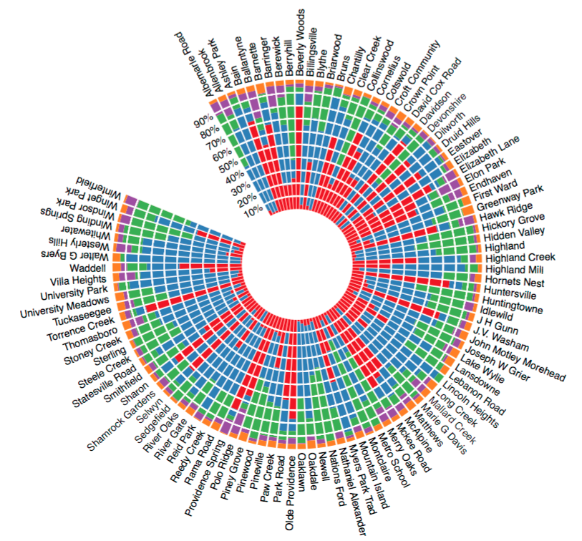
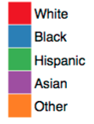
Racial Breakdowns by Elementary School
Race
Jefferson County
Mecklenburg County
Race
Race
Jefferson County
Jefferson County

Slide 43
Racial Breakdowns by Elementary School
A comparison of the polar histograms shows that Jefferson County schools appear to be more integrated than Mecklenburg County Schools.
Note the predominantly red bars for Mecklenburg.
Jefferson County schools are less likely to be dominated by a single racial group, whereas in Mecklenburg County, single race majority schools are frequent.
Notes:
Remember to provide a transition and to make sure they understand that the literature provides guidelines on effective notification messaging that they are probably already familiar with
South Asian tsunami, many people perished because the alert messages were not taken to be that urgent.

Slide 44
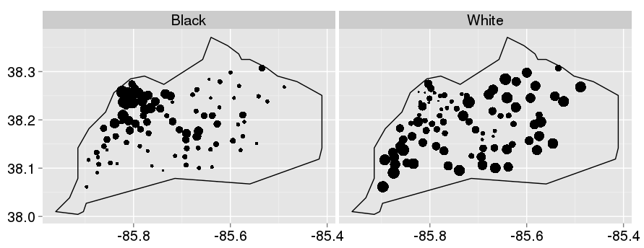
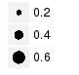
Spatial Correlations - Jefferson
Proportion
Latitude
Longitude
Notes:
A basic emergency notification message
The message can be formatted for different types of communication outlets such as email, SMS, or script to be read for an audio message. Therefore, there is no standardized format regarding spacing, line breaks, or other things like that, and there has not been any empirical research showing that font choice affects attention, perception, or behavioral response in a positive way.

Slide 45
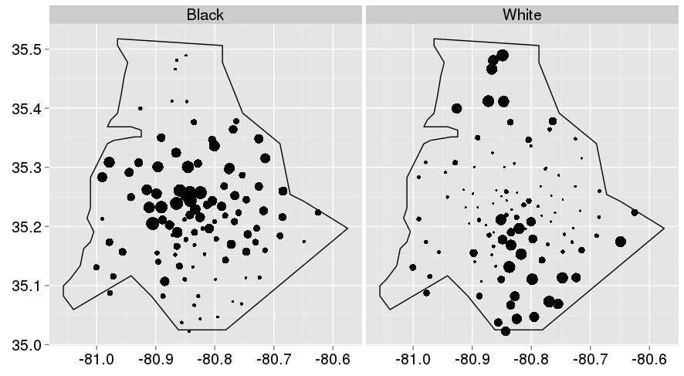
Spatial Correlations - Mecklenburg
Proportion
Latitude
Longitude

Slide 46
Spatial Correlations
The spatial graphs show that, in both counties, where Whites are more prevalent, Blacks are sparse and vice versa.
In Jefferson County, the city of Louisville (NW) schools are largely populated with minorities, while the outer suburbs schools are largely populated by whites.
A similar effect is observed in Mecklenburg schools near the city of Charlotte (center).
Notes:
The content of the messages should be written at a 6th-grade (or lower) reading level since most individuals are stressed in emergency situations and cannot think as critically. Author recommends using the Flesch Reading Ease scale to measure comprehension difficulty of text on a 100 pt scale. It is known as the 60 & 6 principle (60 reading ease score & 6th grade comprehension level). Note though that these principles are just guidelines.

Slide 47
Conclusions
The Jefferson County integration plan has not fully broken down racial segregation in elementary schools, but it is an improvement over integration based solely on location.

Slide 48
Assessing the Influence of career & college readiness

Slide 49
Introduction to Kentucky’s Policy
2009 Senate Bill 1
The Kentucky Senate Bill 1 was passed to address the high rate of students enrolled in remedial courses during their first year of college. This bill created two benchmarks as a solution:
College Readiness: meeting benchmarks on either the ACT, COMPASS, or KYOTE (college placement tests) indicating that they do not require placement in remedial college courses for Math, English, and Reading
Career Readiness: certification in an industry or testing above certain benchmarks on WorkKeys or ASVAB and KOSSA, in addition to completing coursework in Career and Technical Education curriculum
While these benchmarks were introduced in 2009, they were not tracked until the graduating class of 2012.

Slide 50
Overview of the Literature
Defining Career and College Readiness
Only 42% of the 2009 graduating class nation-wide is ready for a college Algebra course, 67% for an English course, and 53% for a Social Sciences/Reading course (ACT, 2009)
High school graduates, college instructors, and employers maintain that high schools are not adequately preparing their graduates
No consensus about the definitions of College and Career Ready
Kentucky is one of 9 states, as of 2012, to publish state-wide criteria, but very few evaluative studies are available and most are qualitative
All students in Kentucky take the ACT in 11th grade and their score is then used to determine if they will need to be placed in remedial courses should they choose to attend college

Slide 51
Direct Evaluation of the Policy
The bill set the target that by 2014-15, remedial course placement should be half what it was in 2009-10
Remedial placement was cut in half in only 5 districts for Mathematics, 5 districts for English and 0 districts for Reading. However, 96% of the state did show some improvement in at least one area
Remedial course placement increased in 21 districts for Mathematics, 16 districts for English, and 17 districts for Reading

Slide 52
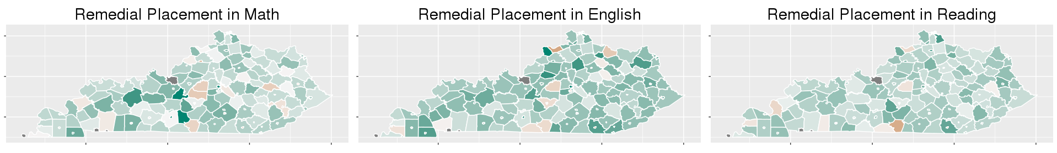
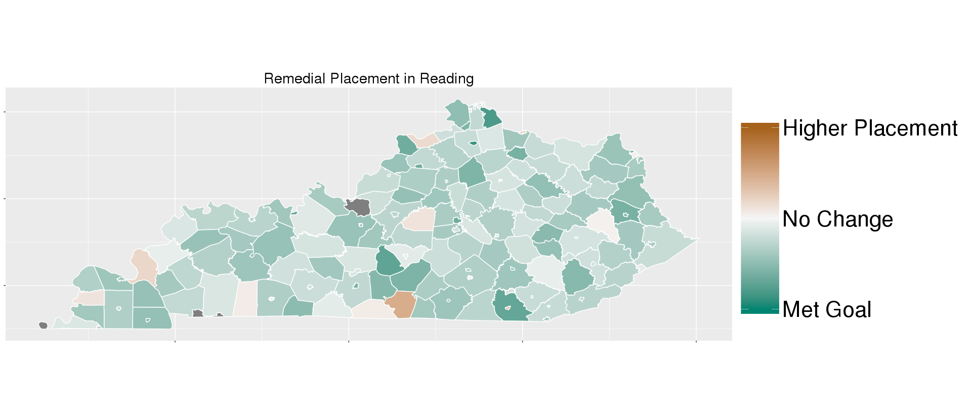
Direct Evaluation of the Policy
Mathematics
English
Reading
Change in the proportion of students in each school district that would be placed in remedial courses based on their Junior Year ACT Score from the graduating class of 2010 to 2015
50% Increase
No Change
50% Decrease
Mathematics
Mathematics

Slide 53
Direct Evaluation of the Policy
Remedial Course Placement, All Districts Combined
Graduating Class | Math | English | Reading
2010 | 66% | 54% | 62%
2015 | 56% | 43% | 52%
Ratio Change | 15% ↓ | 20% ↓ | 16% ↓
Ratio Change = (2010 Placement – 2015 Placement)/2010 Placement

Slide 54
Differences in Remedial Placement by Race
Proportion of Students
Mathematics
English
Reading
White
Non-White
There was a general decline in remedial course placement across 2009-2014, however white students consistently performed better than non-white student

Slide 55
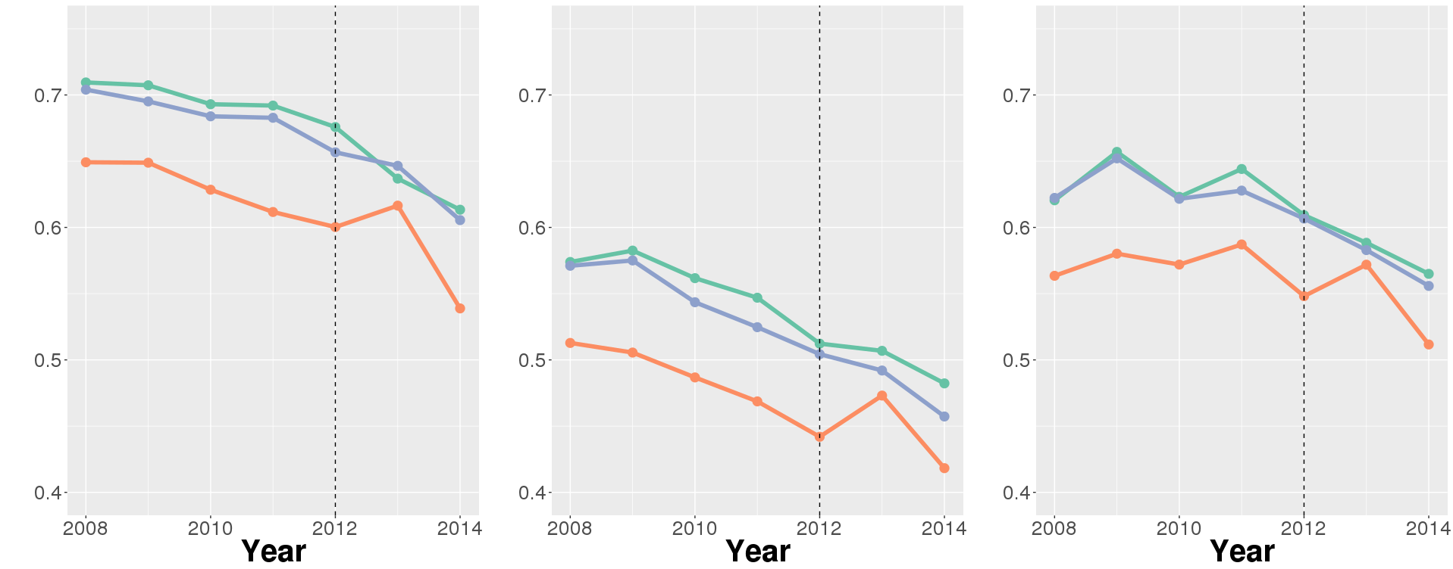
Differences in Remedial Placement by Career Readiness
Proportion of Students
Mathematics
English
Reading
Low
Medium
High
Districts with a higher proportion of Career Ready Students have a higher proportion of remedial course placement
Not much difference between High and Medium Career Ready Districts

Slide 56
Contacts
Organizers of the DSPG program: Dr. Gizem Korkmaz at gkorkmaz@vbi.vt.edu and Dr. Aaron Schroeder at aschroed@vbi.vt.edu
Applications related to DSPG Fellows Program: SDAL Administrative Services Coordinator, Kim Lyman at klyman@vbi.vt.edu or (571) 858-3100
Applications related to DSPG Honors Program: Biocomplexity Institute Education and Outreach Specialist, Dr. Shernita Lee at shernita@vbi.vt.edu or (540)-231-7531
Website: https://www.bi.vt.edu/sdal/careers/call-for-students

Slide 57
NEIGHBORHOOD Diversity in arlington county

Slide 58
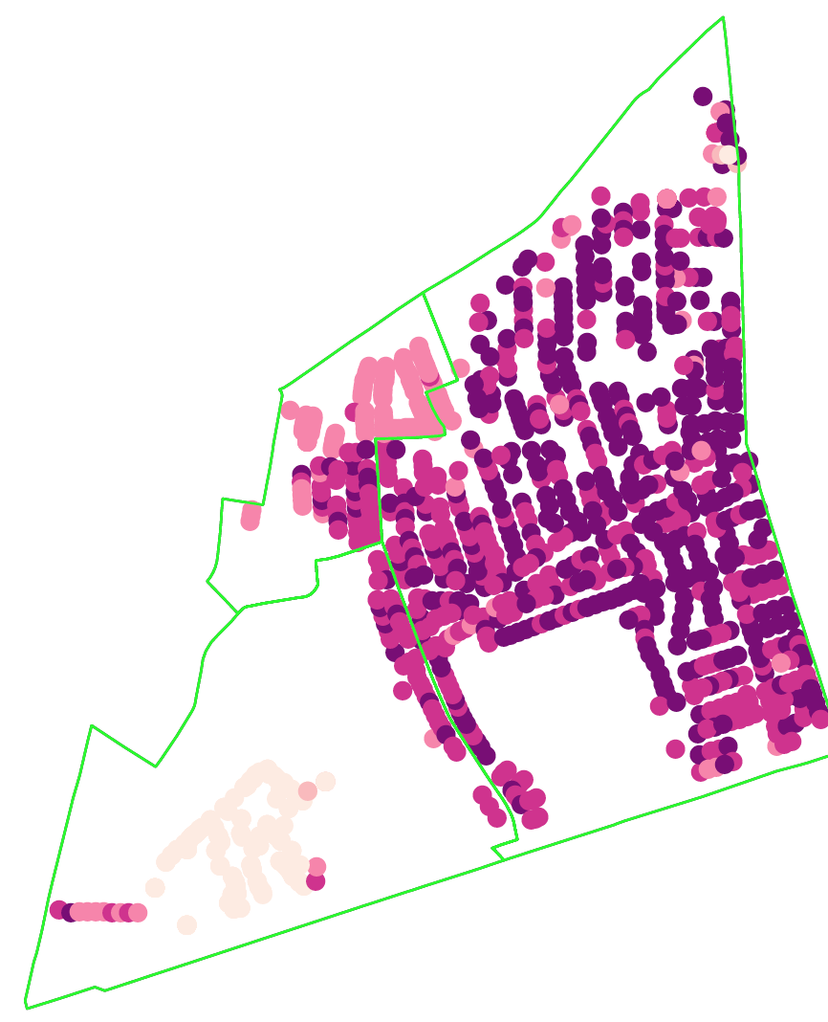
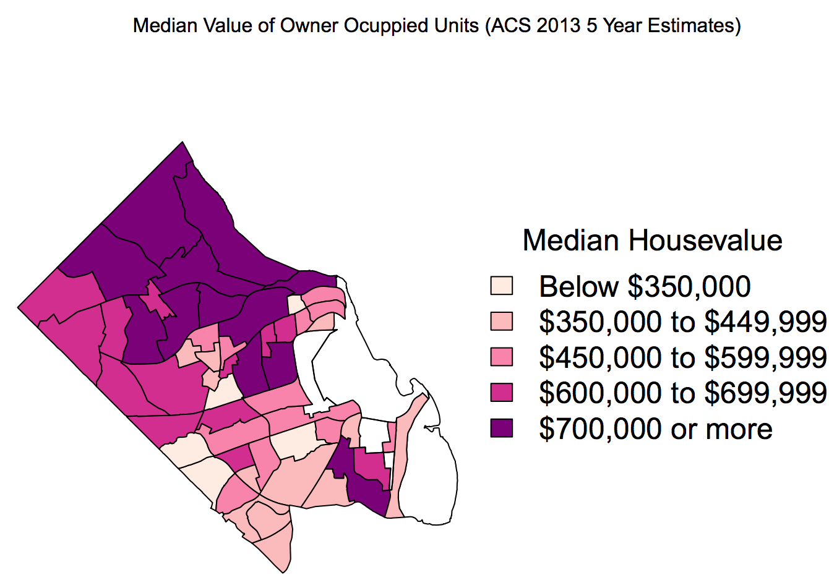
Characterizing Our Neighborhoods Through Federal & Local Data
Median House Value
Owner Occupied Units
American Community Survey (ACS) 2009-2013 Estimate
Individual Assessment Values
2013 Arlington County Real Estate Data
Scale

Slide 59
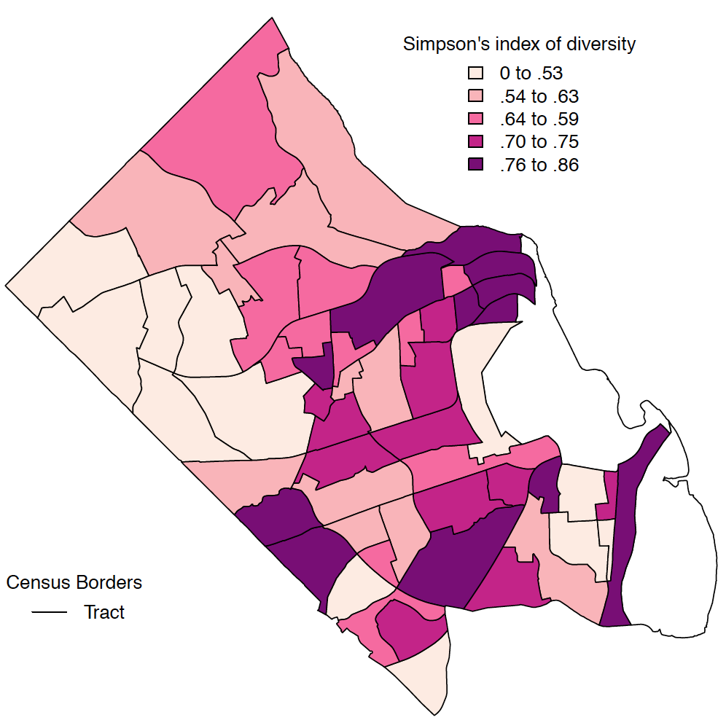
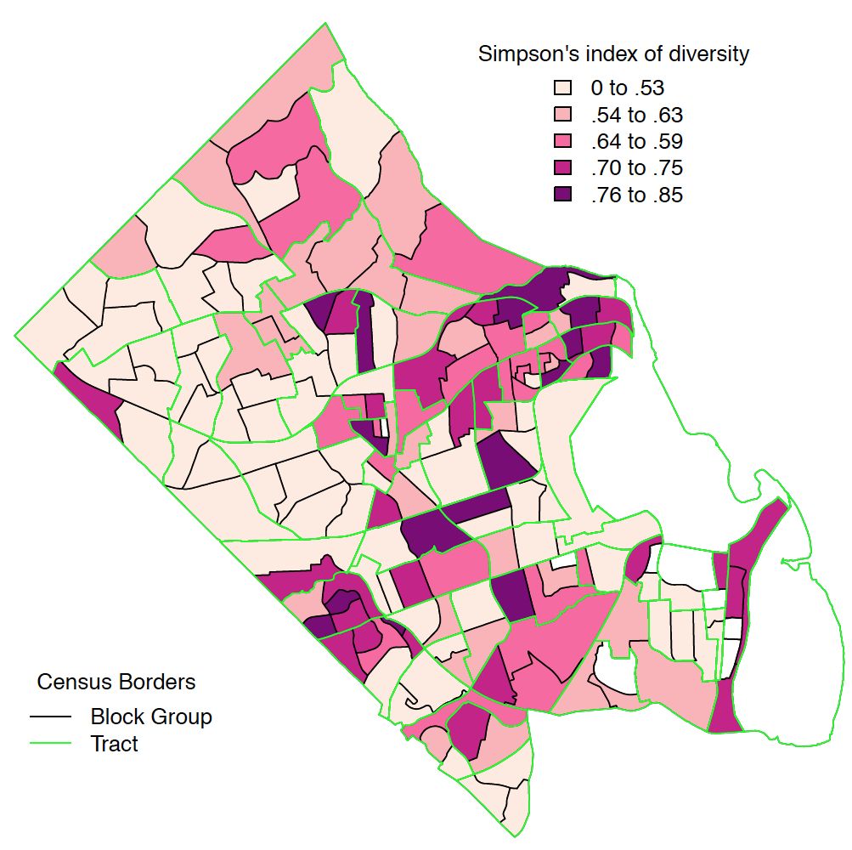
We used house value as wealth surrogate to identify drivers of value and estimate wealth diversity
Census
Block Group
Census
Tract
Source: Arlington County Real Estate Assessment 2013
Notes:
Investigating the determinants of house value
Estimating house value based on house characteristics:
Number of bedrooms, number of units, year built, lot size
Estimating house value based on neighborhood characteristics:
Block Group Characteristics: Median year built, % vacant units, median income, % poverty, % receiving SNAP, % unemployed, % married, % degree, % in school
Census Tract
Data sources are linked
American Community Survey 2009- 2013 and Public Use Micro Data 2013
Arlington County Real Estate, 2013
Multiple Listing Services data, 2013
Use four balls: Text box: Build a local sustainable culture and capability of community using your own data flows.

Slide 60
Estimating employment

Slide 61
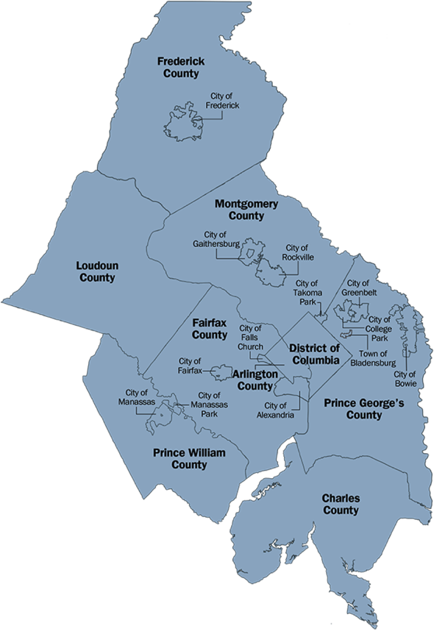
Who is in working in our city during the day?
The Metropolitan Washington Council of Governments (MWCOG) apportions transportation funds to the 22 local governments in the MWCOG based on a formula that relies on the federal administrative data sources:
BLS Quarterly Census for Employment and Wages (QCEW) covered by unemployment insurance
BLS Current Employment Survey for employment not covered by unemployment insurance
CENSUS American Community Survey for self-employed and unpaid family workers
DoD Base Structure Reports (BSR) for the active duty military personnel
Figure from: www.mwcog.org/

Slide 62
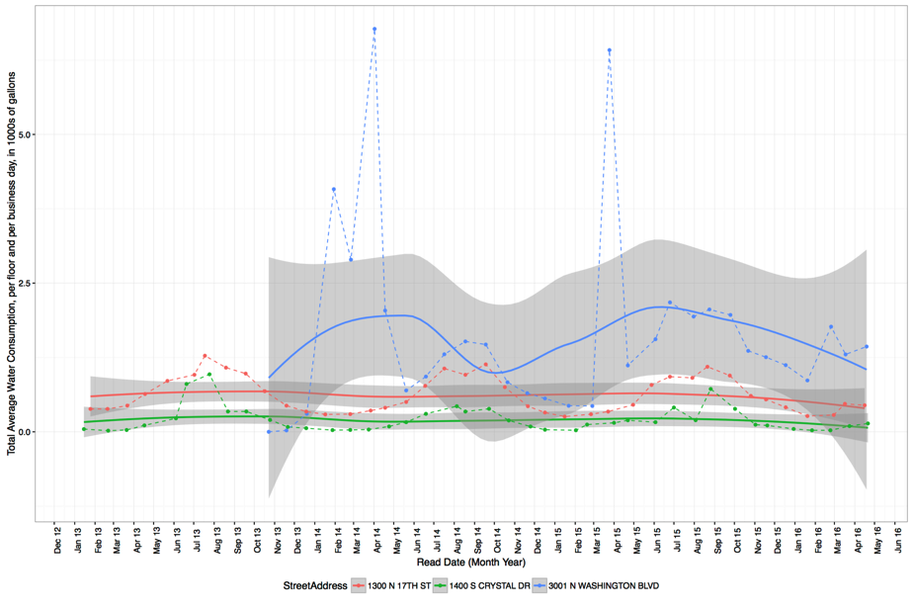
Surrogate Data Source Proof of Concept: Building Water Usage
Building water usage: restrooms, landscaping, kitchens, cooling, laundry
Assumptions: office only, no laundry; no landscaping; constant cooling T∘ 24/7
Use the model to calculate the min/max water usage due to cooling and subtract from total water usage
Model water usage as a function of cooling degree days
Estimate the water usage per male/female employee and visitor, estimate the mean, min., and max. occupancy
Monthly water usage for 3 different buildings types
Example: QCEW=135, Mean Water Estimate=124 (30, 218)

Slide 63
References
^{[1]} Kentucky Department of Education and Kentucky Council on Postsecondary Education. (2010). Unified Strategy for College and Career Readiness Senate Bill 1 2009.
^{[2]} Career/College Readiness for All. (2015). http://education.ky.gov/educational/CCR/Pages/default.aspx
^{[3]} ACT(2009). ACT Profile Report - National: Graduating Class 2009. Iowa City, IA.
^{[4]} Peter D. Hart Research Associates. (2005). Rising to the challenge: Are high school graduates prepared for college and work? Washington, DC: Achieve.
^{[5]} Maruyama, D. (2012). Assessing college readiness: Should we be satisfied with ACT or other threshold scores? Educational Researcher, 41(7), 252-261.
^{[6]} Conforti, P. A. (2013). What is College and Career Readiness? A Summary of State Definitions. Pearson Bulletin, 22, 1-5.
^{[7]} Bragg, D. D., & Taylor, J. L. (2014). Toward College and Career Readiness: How Different Models Produce Similar Short-Term Outcomes. American Behavioral Scientist, 58(8), 994-1017. doi:10.1177/0002764213515231

Slide 64
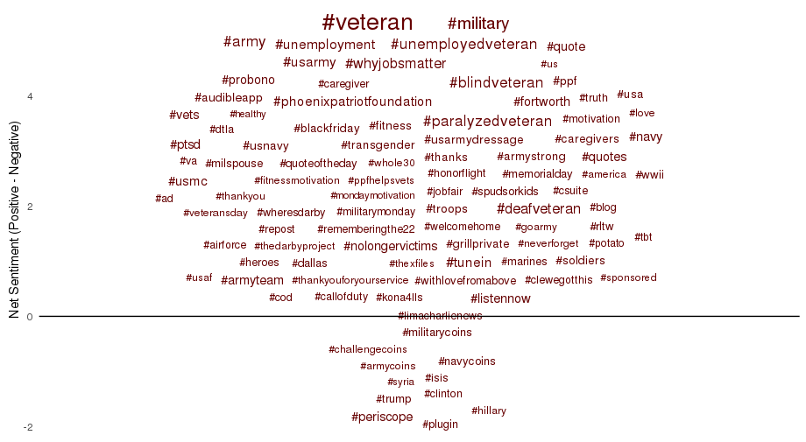
#Hashtag Sentiments
Analyzed the sentiments in the tweets that contain the 100 most frequent hashtags.
Most hashtags are more positive than negative.
Notes:
Tweets with #veteran tend to be the most positive, and tweets about the election tend to be the most negative.

Slide 65
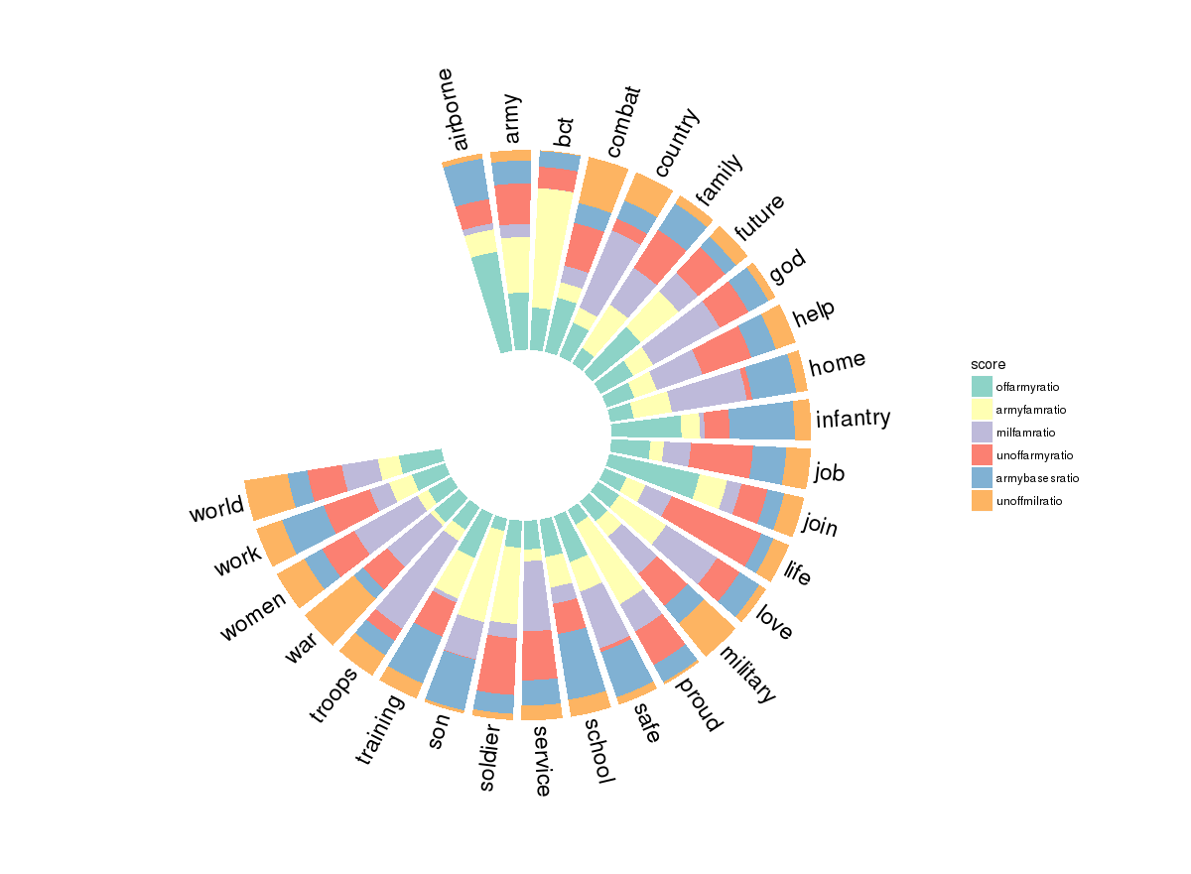
Topics by Group
Groups
The fraction of word frequencies over the total number of words in the comments is calculated for each group.
Certain words are used much more frequently in particular groups of pages (e.g., “troops” most used on Military Family pages, “join” most used on Official Army pages).
Official Army
Army Family
Military Family
Unofficial Army
Army Bases
Unofficial Military

Slide 66
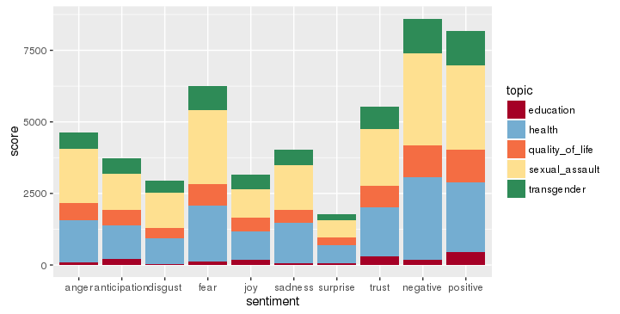
Sentiments by Topic
The sentiments vary for each topic with the total sentiment being more negative.
Barring positivity and negativity, fear is the main sentiment expressed with respect to sexual assault and health.
anger
anticipation
disgust
fear
joy
sadness
surprise
trust
negative
positive

Slide 67
Drivers of Value: Hedonic Specification
Investigating the determinants of house value.
Estimating house value based on house characteristics:
Number of bedrooms, number of units, year built, lot size
Estimating house value based on neighborhood characteristics:
Block Group Characteristics: Median year built, % vacant units, median income, % poverty, % receiving SNAP, % unemployed, % married, % degree, % in school
Census Tract
Data sources
ACS PUMS 2013
Arlington County Real Estate, 2013
Multiple Listing Services data, 2013

Slide 68
Hedonic Regression: Estimated Home Values
Detached Home
1 acre or less, 3 bedrooms
Built 2005-2009
Tract 1002, Block Group 1
Condo
Multi-unit building, 2 bedrooms
Built 2005-2009
Tract 1014.02, Block Group 1
0 $500K $1M $1.5M $2M
0 $300K $600K $900K $12M
Source: Arlington County Real Estate Assessment 2013; Arlington MLS 2013

Slide 69
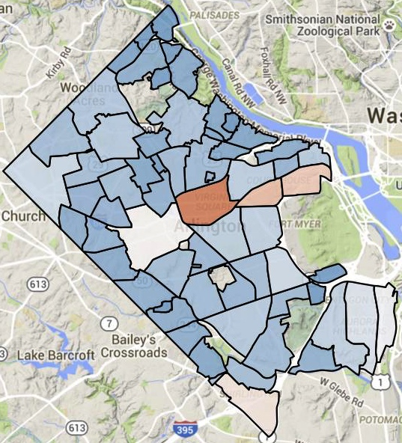
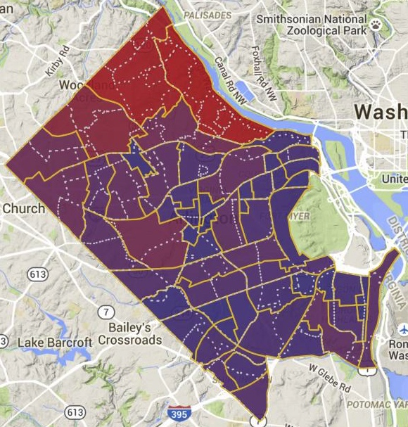


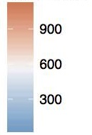
How many people are enrolled in Arlington Alerts & where?
High
Low
Enrollment per Civic Association
Enrollment by Block Group

Slide 70
Other Quotes
“While classwork is heavy on numbers, being able to work directly with people at Arlington County government is eye-opening. It gives you a broader context and changes your world view.”
- Adrienne Rogers, of Blacksburg, Virginia, then a rising senior majoring in statistics and sociology at Virginia Tech
“I never realized how much time it takes to clean the data into the right form. Now I know and can really appreciate all the effort.”
- Will Sandholtz, then a rising junior at U of California, Berkeley
"All of our projects involved interesting issues with a clear need for statistical expertise, and a direct impact on the communities we worked with."

Slide 71
Other Quotes
“Our overarching objective is to equip new generations of scientists with skills they need to provide policymakers and government leaders with data analysis support that can inform difficult decisions related to healthcare, education, and social justice.”
- Sallie Keller, professor of statistics and director of the Social and Decision Analytics Laboratory
“It’s not easy to find a program like Data Science for the Public Good that combines my two majors — statistics and psychology. This is a great opportunity for me to work on an issue I am passionate about.”
- Emily Stark, who is hoping she can apply some of what she learns to education solutions in Tennessee, where she attends college

Slide 72
Diversify Your Expertise
Work in cross-disciplinary teams, closely supported by graduate research assistants and supervised by faculty.
Individualized mentors in a wide variety of fields: statistics, social, behavioral and economic sciences, computer science, simulation, data analytics, information technology policy, and infrastructural resilience.
"The interdisciplinary work environment made it easy to connect and have conversations. If I wanted to ask a question about another field of research, there was always a door I could knock on.”
- DSPG Fellow 2016

